Slide 1
COMMUNICATION Chapter 7
Avis Turner, LCSW
Desiree Glover, M.Ed.
Robert Simms, M.S.

Slide 2
Overview
Chapter 7: Communication
Communication Defined
The Communication Process
Nonverbal Communication
Direction of Communication
Communication Networks
Barriers to Communication
Overcoming Communication Barriers
Application to Standards
Discussion Questions
References

Slide 3
Communication Defined
The process that links the individual, group and organization.
mediates the inputs from the environment
outputs from the organization to the environment.

Slide 4
Communication Process
Sequence that involves six key components:
Ideating
Encoding
Transmitting
Receiving
Decoding
Acting

Slide 5
Diagram of the Two-Way Communication Process
Messages
Sender
Receiver
Barriers
Barriers
Ideates
Encodes
Transmits
Receives
Decodes
Acts
Feedback

Slide 6
Nonverbal Communication
Kinesis
Body movements and position
relates to how our facial expression impacts communication.
Paralanguage
Voice qualities
Proxemics
Space and proximity
refers to the physical environment of communication and deals with space and location of the communication.
Chronemics
-- Determination and definition of time
-- relates to the use of time and the messages sent when the sender is punctual or late.

Slide 7
Direction of Communication
Communication Flows
Downward Communication
Upward Communication
Employee Meetings
Open Door Policy
Employee Letters
Participation in Social Groups
Horizontal Communication
Diagonal Communication
The Grapevine

Slide 8
Communication Networks
Network Patterns
Wheel Network
Chain Network
Y Network
Circle Network
Star Network
Effectiveness of Different Networks
Speed
Accuracy
Morale
Leadership stability
Organization
Flexibility
Network Analysis

Slide 9
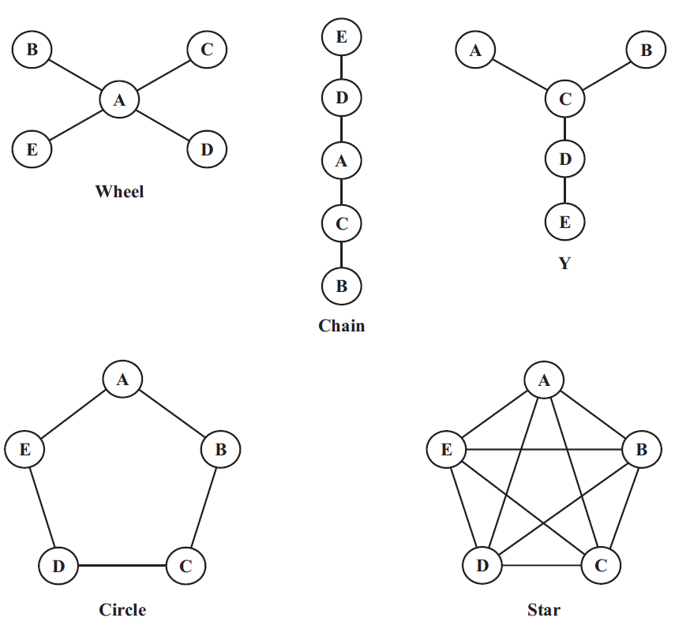
Communication Networks

Slide 10
Barriers to Communication
Why consider?
Vital to goal achievement
Barriers:
Frames of reference
Filtering
Structure
Information overload
Semantics
Status difference

Slide 11
Overcoming Barriers to Communication
Effective communication requires a sustained effort.
The five communication skills required are:
Repetition
Empathy
Understanding
Feedback
Listening

Slide 12
Listening Styles
The six listening styles below were developed by Performax Systems International.
The Six Listening Styles
Leisure Listening
Inclusive Listening
Stylistic Listening
Technical Listening
Empathetic Listening
Nonconforming Listening
Since research shows that
administrators spend as much as
85% of their communication
time talking it appears that the
first rule for good listening is to stop
talking.

Slide 13
Application of the Standards
Standard 1 Indicators:
1.2 a. Articulate components of vision.
1.2 c. Communicate school/district vision.
Standard 2 Indicators:
-- All
Standard 3 Indicators:
3.1.a. Optimize the learning environment by applying appropriate models of organizational management.
3.2.a. Involve staff in conducting operations and setting
priorities using needs assessment, research-based data, and group process skills to build consensus.
3.2.b. Develop communications plans for staff to develop family and community collaboration skills.
3.3.c. Apply and assess current technology for school management, business procedures, and scheduling. Standard 2 Indicators:
Standard 4 Indicators:
-- All
Standard 5 Indicators:
5.1.a. Demonstrate a respect for the rights of others with regard to confidentiality, dignity, and engage in honest communications.
5.2.a. Combine impartiality, sensitivity to student diversity, and ethical considerations in interactions with others.
5.3.a. Makes and explain decisions based on ethical and legal principals.
Standard 6 Indicators:
-- All

Slide 14
Discussion Questions
Why is it important to communicate effectively in education settings?
Can the communication process be used with all cultural and linguistic groups? Please explain your answer and provide evidence of how you would apply the process with multi-ethnic or linguistic populations different from your own ethnicity.
Describe the primary communication flows at your school or organization.
What are the six barriers to effective communication in a school organization?
Which of the leadership standards relate to communication? Explain.
Formulate a communication model, that will by virtue of its design, employ the five communication skills identified as those that facilitate overcoming barriers to communication.

Slide 15
Answers to Questions
ELCC standards dictate that educational leaders have an ethical duty to create an environment that is conducive to student achievement. As a leader this includes mastering the art of effective communication.
Answers will vary.
Answers will vary, but should include discussion on any of the following communication flows: Downward Communication, Upward Communication, Employee Meetings, Open Door Policy, Employee Letters, Participation in Social Groups, Horizontal Communication, Diagonal Communication, The Grapevine.
Frames of reference, Filtering, Structure, Information overload, Semantics, and Status difference.
Answers will vary, but should discuss how every standard has indicators that address communication.
Make sure all communication is repetitive using a variety of communication methods including but not limited to emails, telephone calls, face-to-face, memorandum, or letter whenever possible. Envision how the receiver will respond, perhaps taking a sample survey. Make sure all expressions are simple enough to be easily understood. Allow for feedback through written, electronic, and verbal discussion at a variety of levels with anonymity as a part of the response opportunity.

Slide 16
References
Lunenburg, F. C., & Ornstein, A. C. (2008). Educational Administration (5th ed.). Belmont, CA: Thomson Higher Education.

